Slide 1
Chapter 9-Digital to Analog Conversion

Slide 2

Introduction
Digital-to-analog conversion is the process of changing one of the characteristics of an analog signal based on the information in digital data.
Digital data needs to be carried on an analog signal.
A carrier signal (frequency f_{c}) performs the function of transporting the digital data in an analog waveform.
The analog carrier signal is manipulated to uniquely identify the digital data being carried.

Slide 3

Types of digital to analog conversion

Slide 4
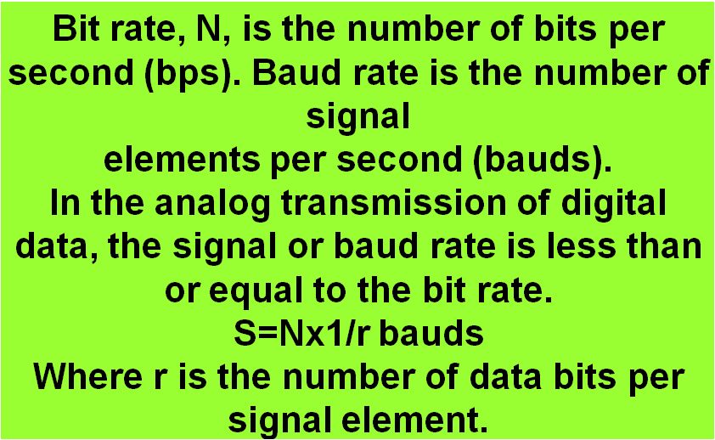
Bit rate and Baud Rate

Slide 5
Example
An analog signal carries 4 bits per signal element. If 1000 signal elements are sent per second, find the bit rate.
Solution
In this case, r = 4, S = 1000, and N is unknown. We can find the value of N from

Slide 6

Example
An analog signal has a bit rate of 8000 bps and a baud rate of 1000 baud. How many data elements are carried by each signal element? How many signal elements do we need?
Solution
In this example, S = 1000, N = 8000, and r and L are unknown. We find first the value of r and then the value of L.

Slide 7
Amplitude Shift Keying (ASK)
ASK is implemented by changing the amplitude of a carrier signal to reflect amplitude levels in the digital signal.
Both frequency and phase remains constant while the amplitude changes.
Which voltage represents 1 and which voltage represents 0 are left to the system designer.
For example: a digital “1” could not affect the signal, whereas a digital “0” would, by making it zero.
Bit duration is the period of time that defines 1 bit.
The peak amplitude during each bit duration is constant.

Slide 8
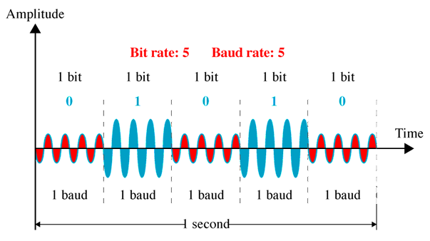
Amplitude Shift Keying (ASK)

Slide 9
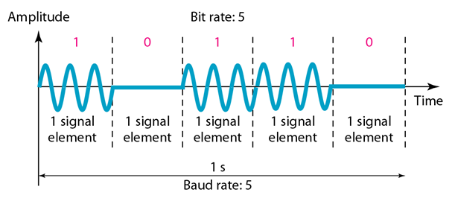
On-off-keying (OOK) or Binary ASK
A popular ASK technique is called on-off-keying (OOK). In OOK one of the bit values is represented by no voltage.
The advantage is a reduction in the amount of energy required to transmit information.

Slide 10
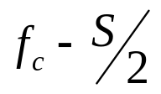
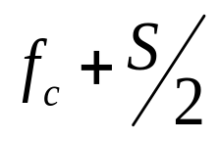
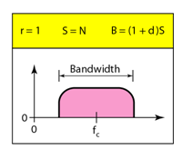
Bandwidth of ASK
Recall that the bandwidth of a signal is the total range of frequencies occupied by the signal.
When we decompose an ASK-modulated signal, we get a spectrum of many simple frequencies.
However, the most significant one are those between
And .

Slide 11
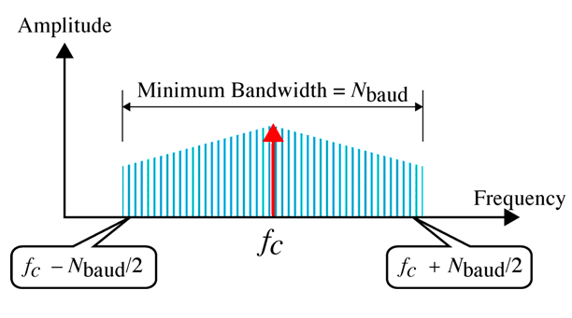
Bandwidth of ASK
The bandwidth B of ASK is proportional to the signal rate S.
B = (1+d)S
“d” is due to modulation and filtering, lies between 0 and 1.
The minimum bandwidth required for transmission is equal to the baud rate.

Slide 12

Implementation of ASK

Slide 13
Example
We have an available bandwidth of 100 kHz which spans from 200 to 300 kHz. What are the carrier frequency and the bit rate if we modulated our data by using ASK with d = 1?
Solution
The middle of the bandwidth is located at 250 kHz. This means that our carrier frequency can be at f_{c} = 250 kHz. We can use the formula for bandwidth to find the bit rate (with d = 1 and r = 1).

Slide 14

Example
In data communications, we normally use full-duplex links with communication in both directions. We need to divide the bandwidth into two with two carrier frequencies, as shown in Figure below. The figure shows the positions of two carrier frequencies and the bandwidths. The available bandwidth for each direction is now 50 kHz, which leaves us with a data rate of 25 kbps in each direction.

Slide 15
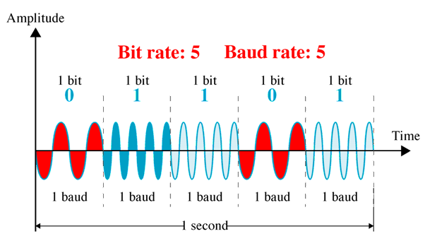
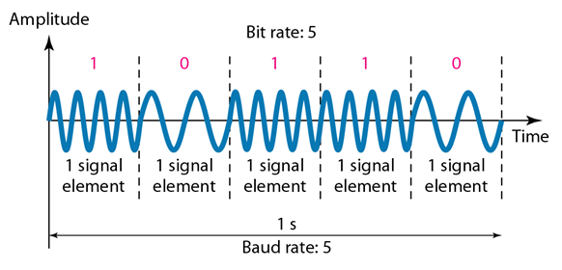
Frequency Shift Keying (FSK)
In FSK, the frequency of the carrier signal is varied to represent binary 1and 0.
The frequency of the signal during each duration is constant.
Both peak amplitude and phase remains constant.
For example, a “1” could be represented by f₁=f_{c} +Δf, and a “0” could be represented by f₂=f_{c}-Δf.

Slide 16

Bandwidth of FSK
If the difference between the two frequencies (f₁ and f₂) is 2Δf, then the required BW B will be:
B = (1+d)×S +2Δf

Slide 17
Example
We have an available bandwidth of 100 kHz which spans from 200 to 300 kHz. What should be the carrier frequency and the bit rate if we modulated our data by using FSK with d = 1 and 2Δf =50kHz?
Solution

Slide 18
Coherent and Non Coherent
In a non-coherent FSK scheme, when we change from one frequency to the other, we do not adhere to the current phase of the signal.
In coherent FSK, the switch from one frequency signal to the other only occurs at the same phase in the signal.

Slide 19

Implementation of FSK

Slide 20
Phase Shift Keying (PSK)
We vary the phase shift of the carrier signal to represent digital data.
Both peak amplitude and frequency remain constant as the phase changes.
The bandwidth requirement, B is:
B = (1+d)×S
PSK is much more robust than ASK as it is not that vulnerable to noise, which changes amplitude of the signal.

Slide 21
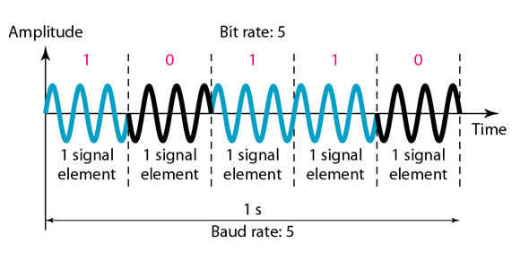
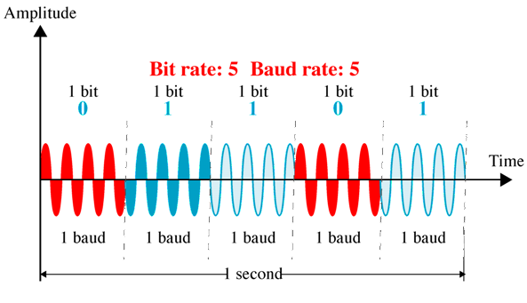
Binary Phase Shift Keying (PSK)
The above method is often called 2-PSK, or binary PSK, because two different phases (0⁰ and 180⁰) are used.

Slide 22

Binary Phase Shift Keying (PSK)

Slide 23

Implementation of BPSK

Slide 24
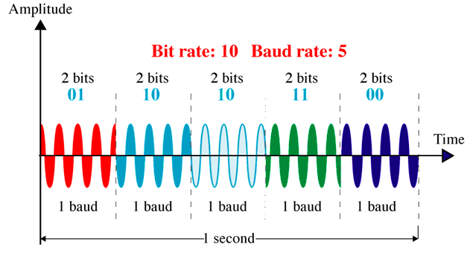
Quadrature PSK
To increase the bit rate, we can code 2 or more bits onto one signal element.

Slide 25
Example
Find the bandwidth for a signal transmitting at 12 Mbps for QPSK. The value of d = 0.
Solution
For QPSK, 2 bits is carried by one signal element. This means that r = 2. So the signal rate (baud rate) is S = N × (1/r) = 6 Mbaud. With a value of d = 0, we have B = S = 6 MHz.

Slide 26

Constellation Diagram
A constellation diagram helps us to define the amplitude and phase of a signal when we are using two carriers, one in quadrature of the other.
The X-axis represents the in-phase carrier and the Y-axis represents quadrature carrier.

Slide 27
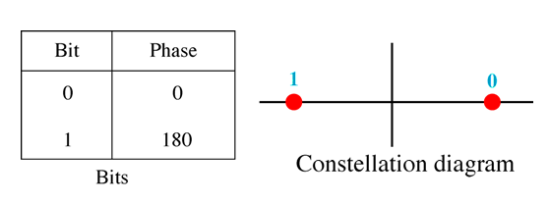
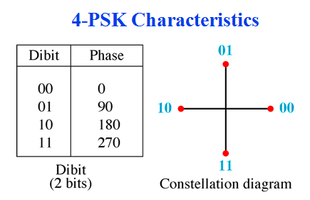
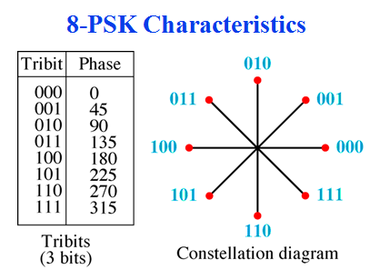
PSK Constellation

Slide 28

Example
Show the constellation diagrams for an ASK (OOK), BPSK, and QPSK signals.
Solution

Slide 29
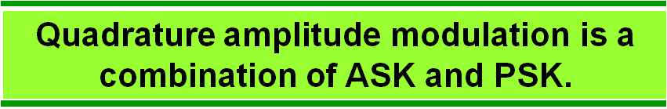
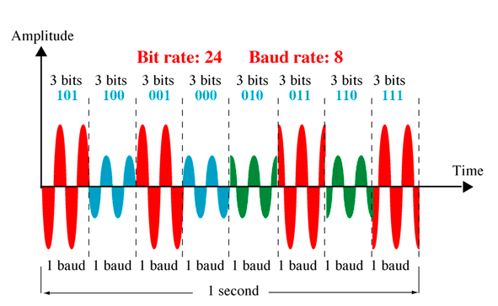
QAM (Quadrature Amplitude Modultion)

Slide 30
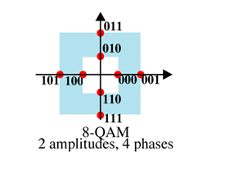
QAM (Quadrature Amplitude Modultion)
Possible variations of QAM are numerous.
Theoretically, any measurable number of changes in amplitude can be combined with any measurable number of changes in phase.
4-QAM and 8-QAM constellation

Slide 31
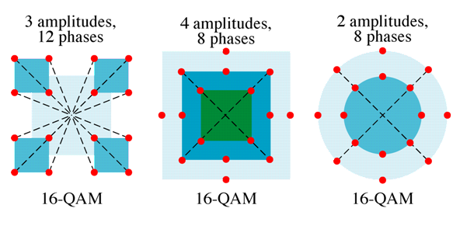
16-QAM constellation

